Slide 1
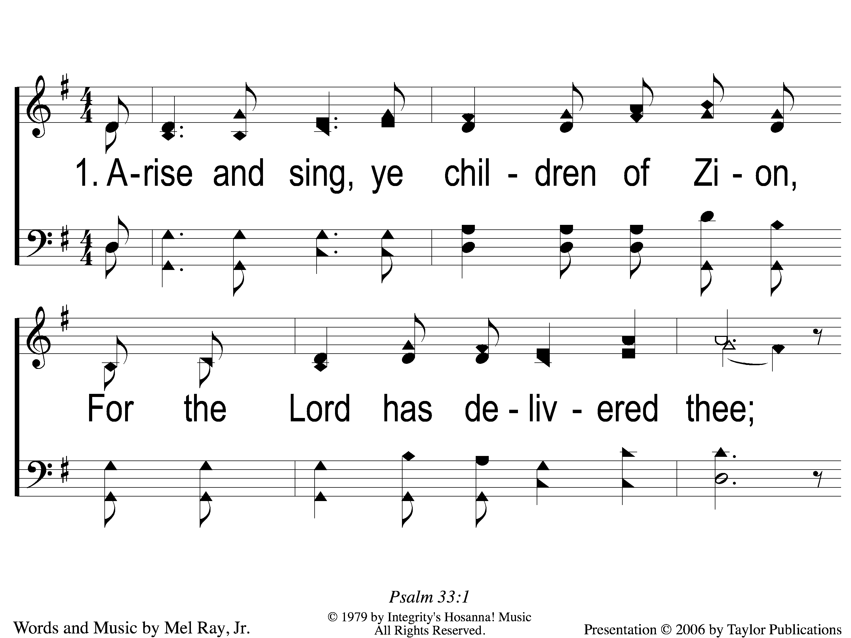
1 Arise and Sing
Arise and Sing
706

Slide 2
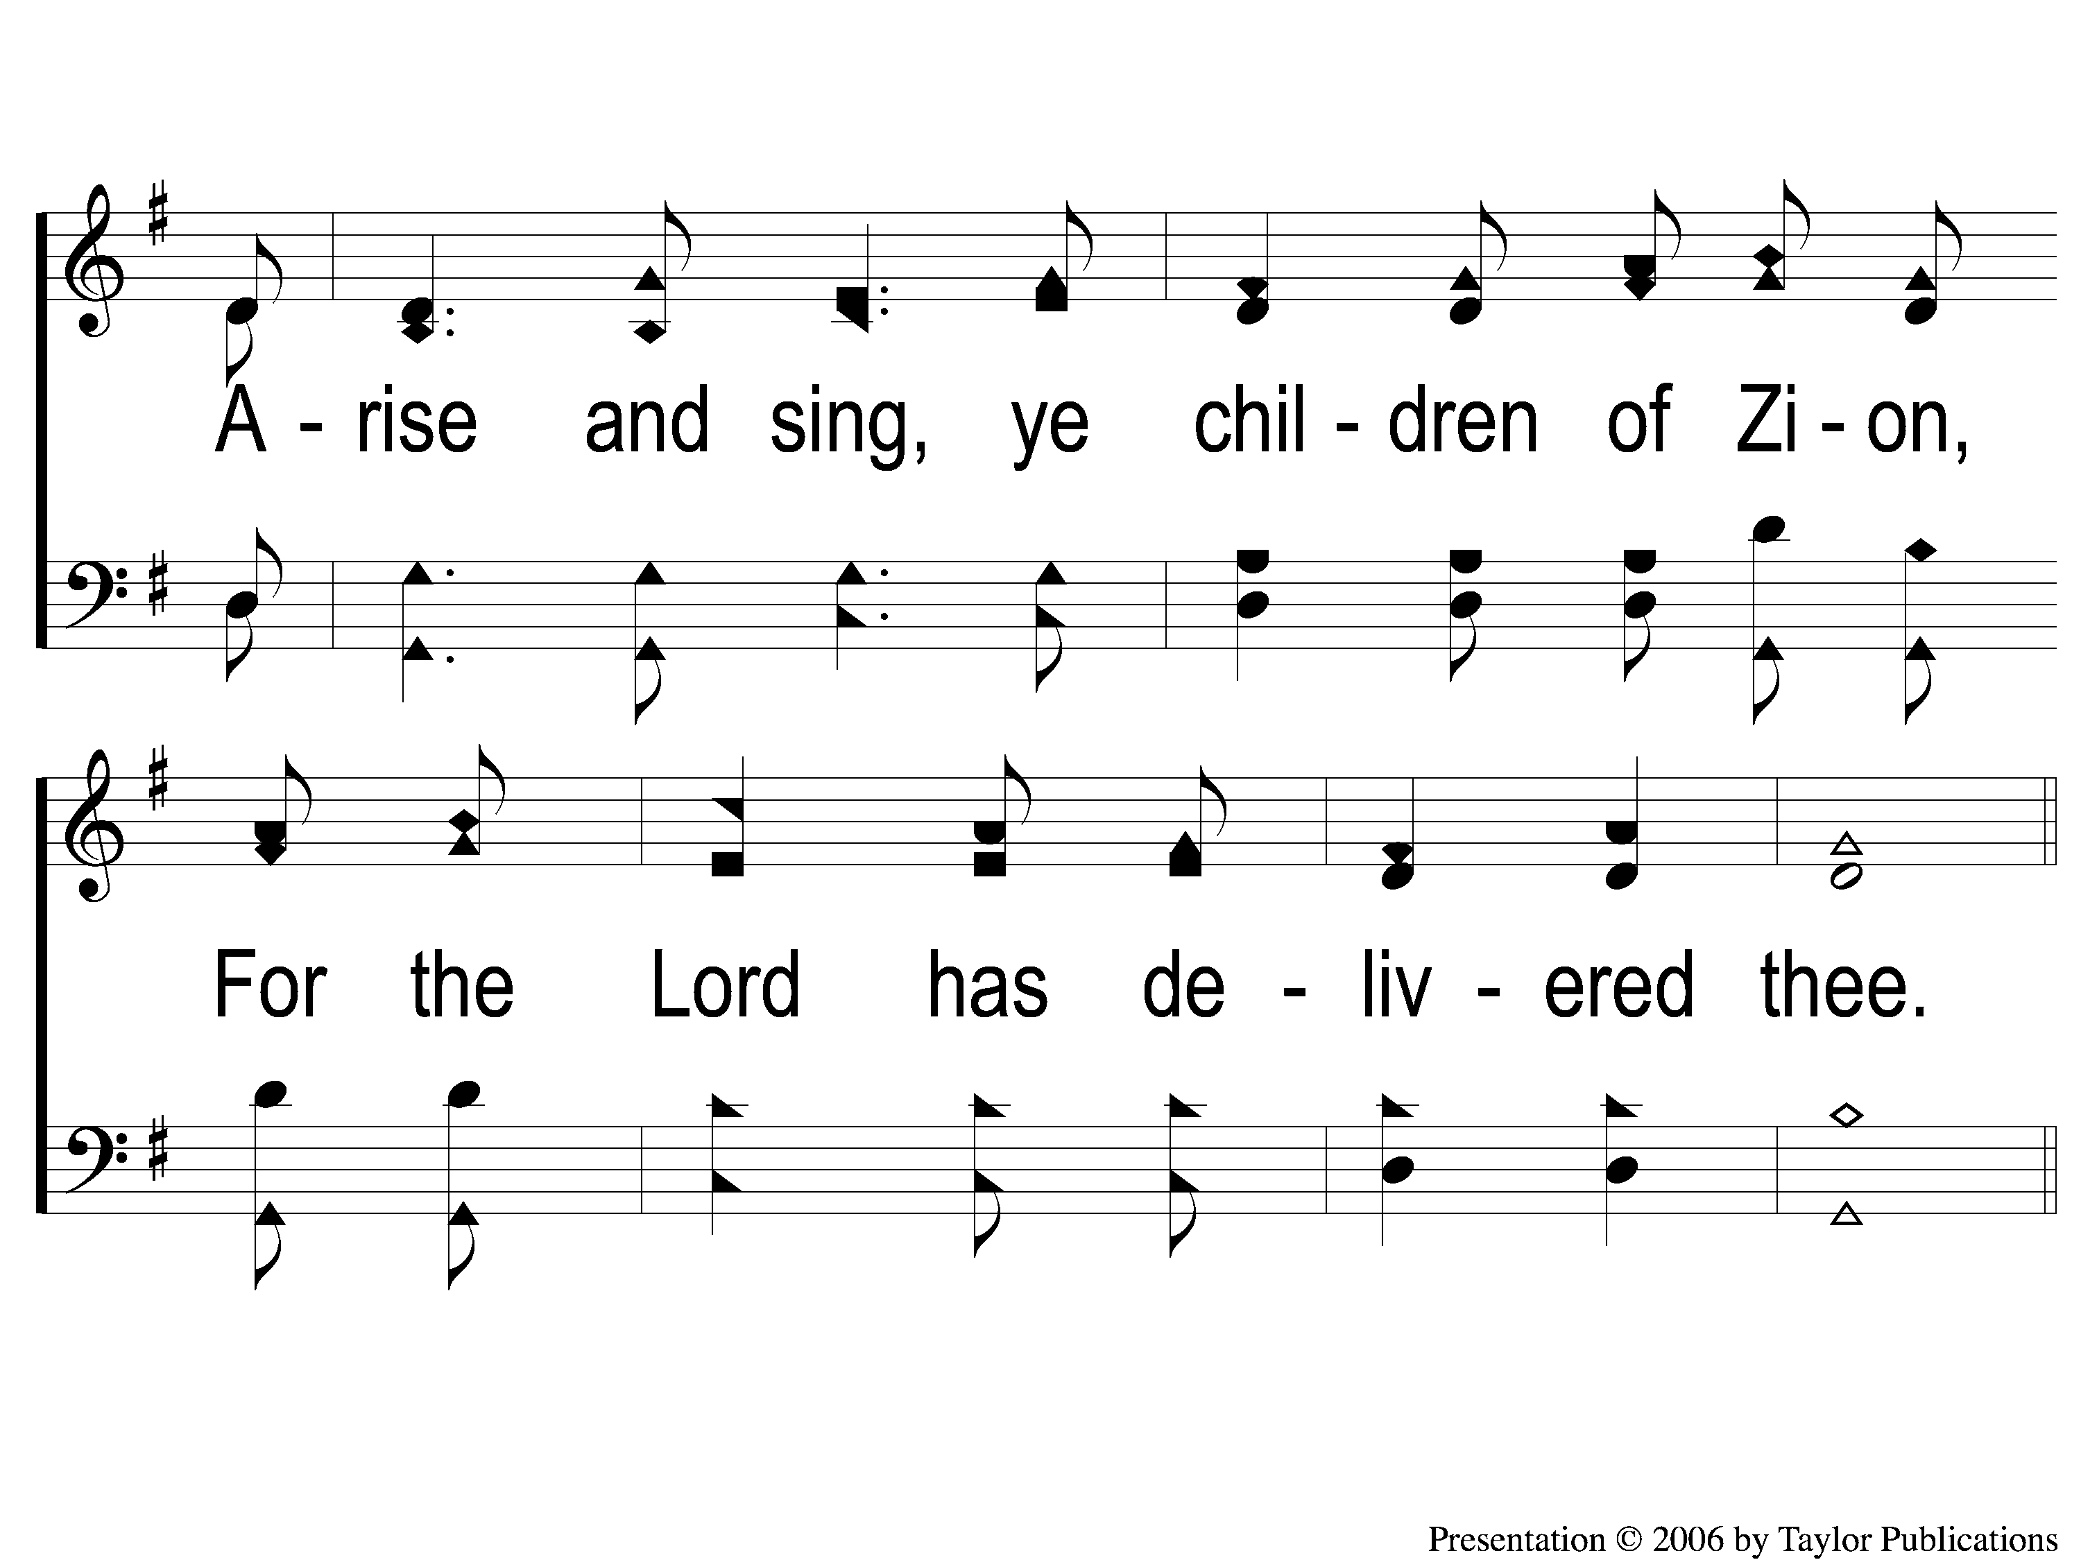
2 Arise and Sing
Arise and Sing
706

Slide 3
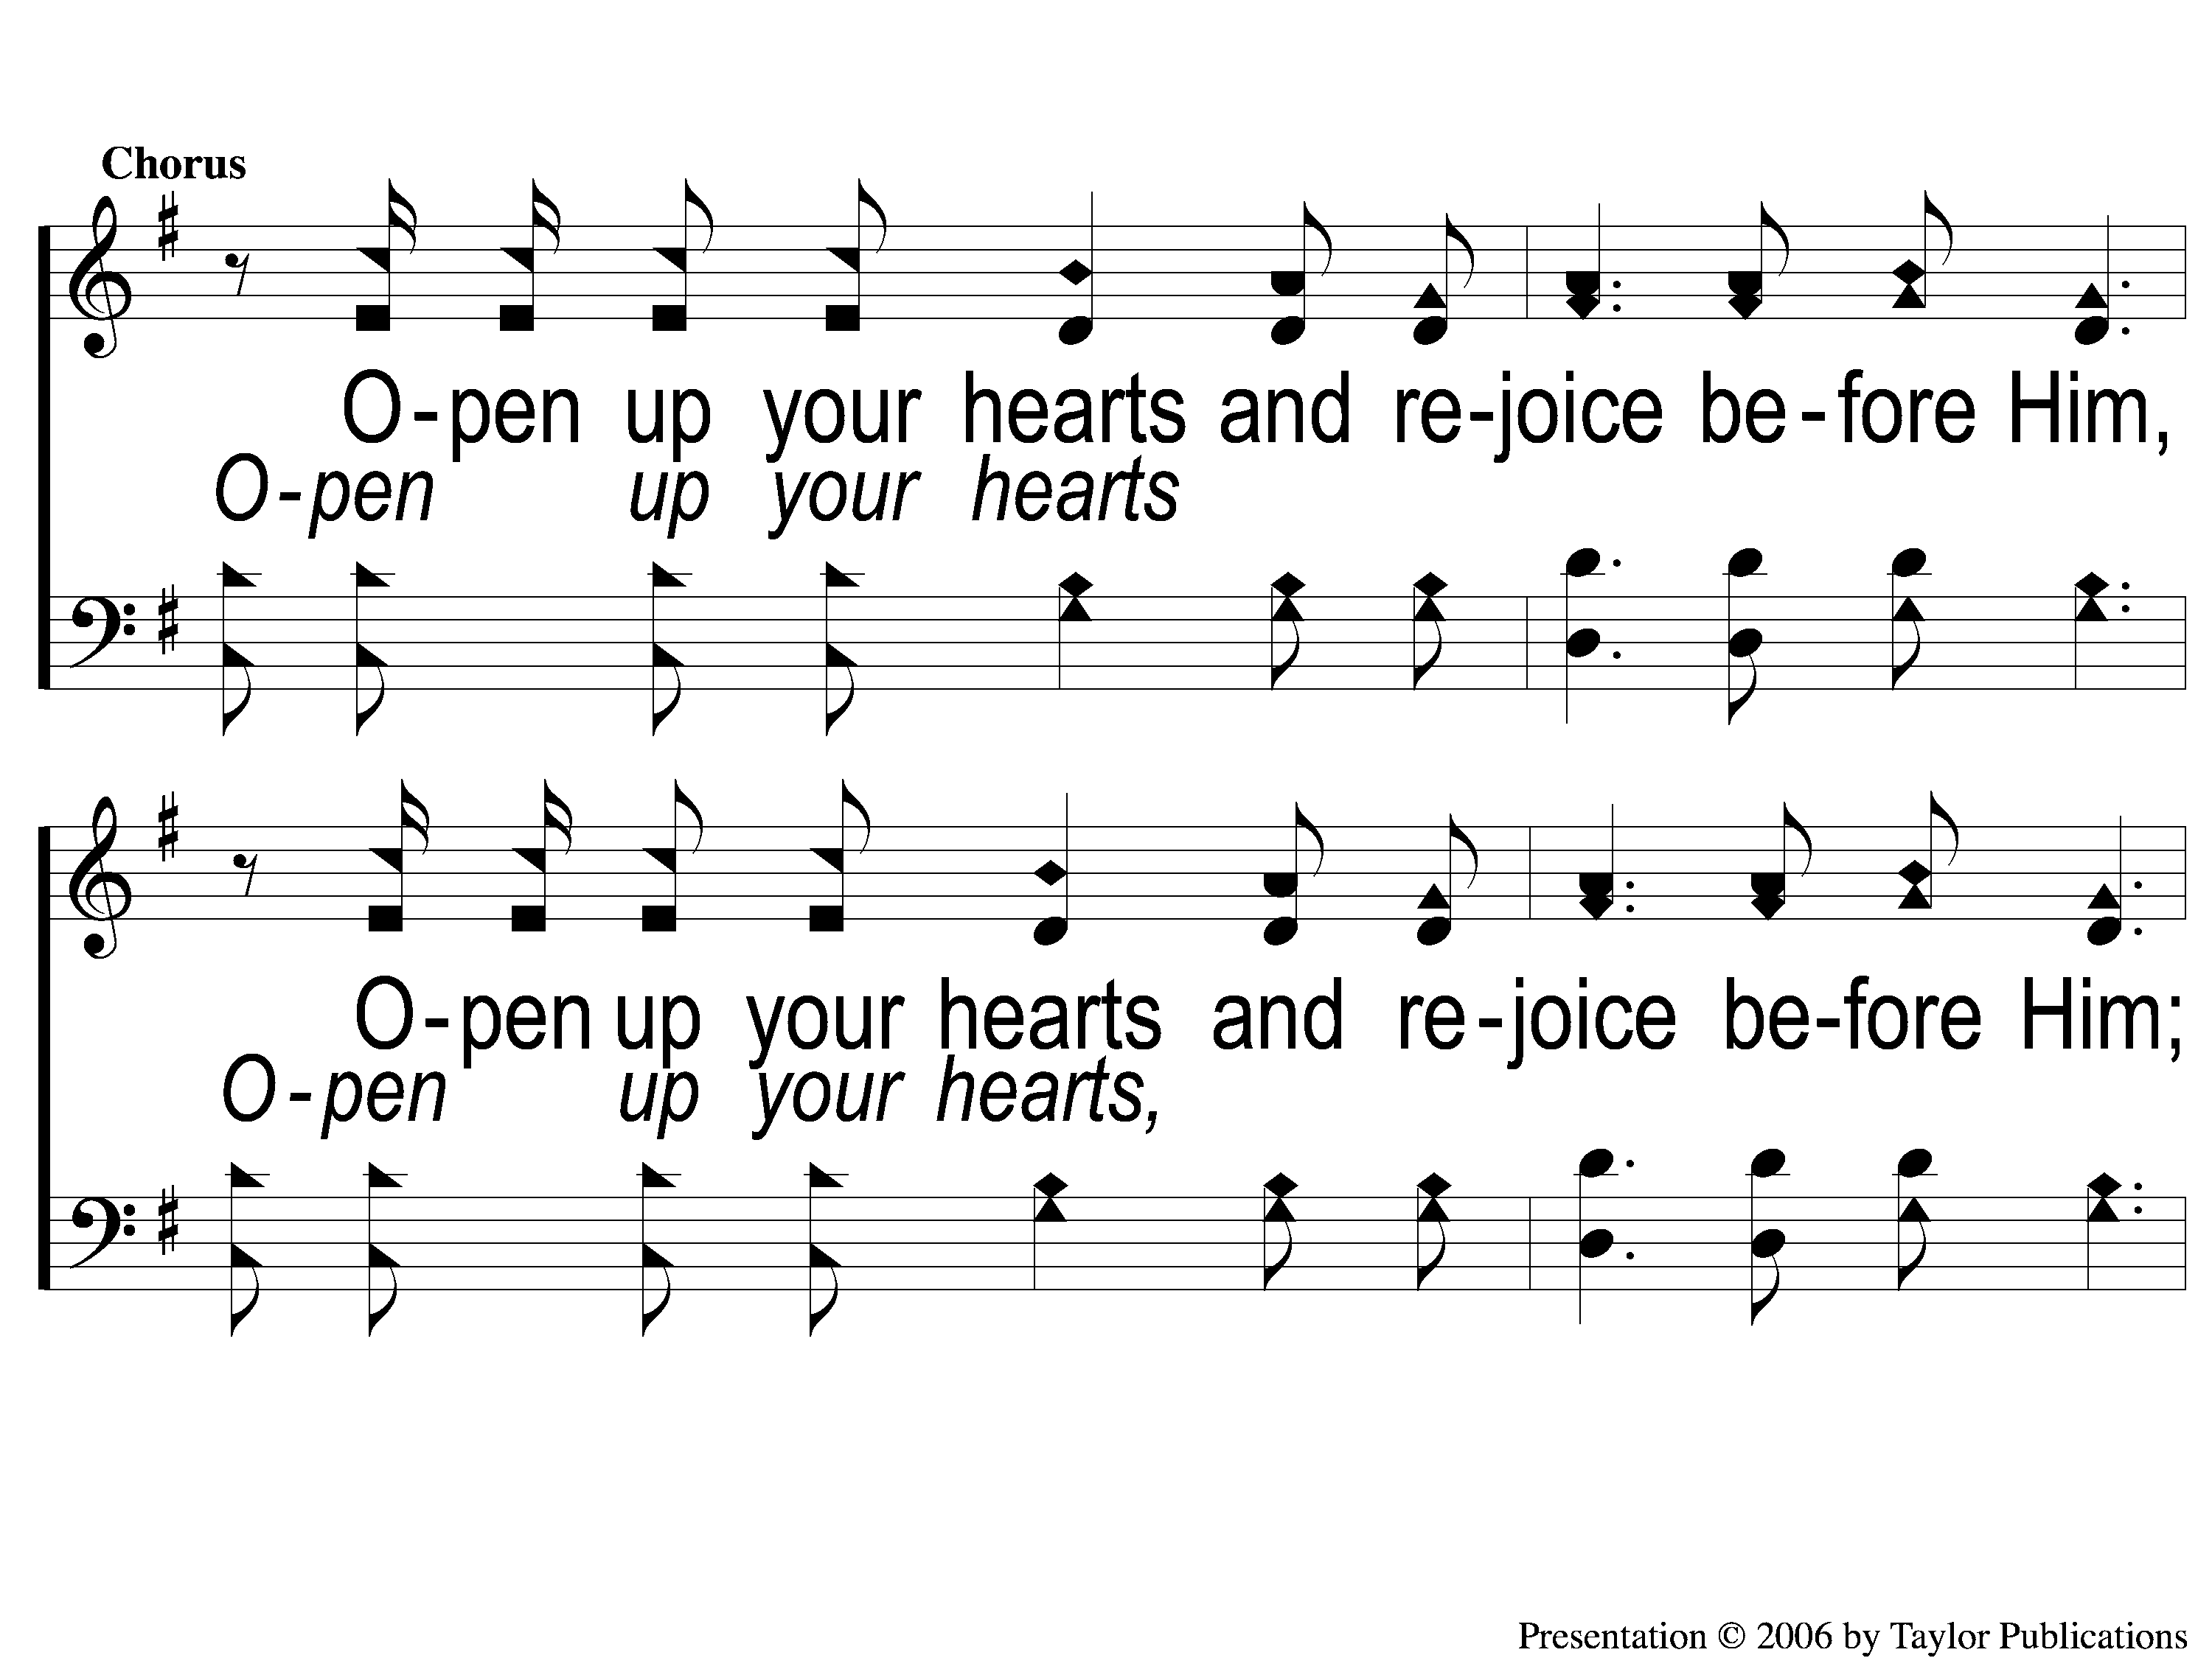
C-1 Arise and Sing
Arise and Sing
706

Slide 4
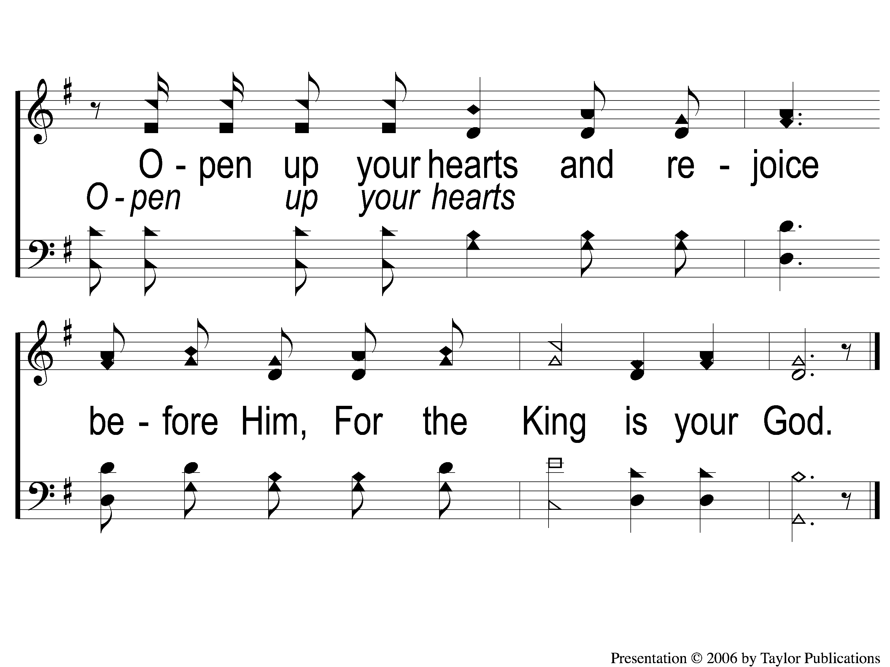
C-2 Arise and Sing
Arise and Sing
706

